Slide 1


Using Pentaho Data Integration for ETL
Ali Chelli
Course: Business Intelligence and Data Warehousing (BID3000)

Slide 2
The ETL Process– Extraction, Transformation, Loading
ETL stands for Extraction, Transformation, and Loading
Extraction: Collect the data from heterogenous data sources
Transformation: transform, clean, and standardize the data such that it can be integrated in the same data warehouse
Loading: consists of loading the data to the data warehouse
Data staging area: the part of the data warehouse where transformations happens
The staging area should not be available for querying

Slide 3
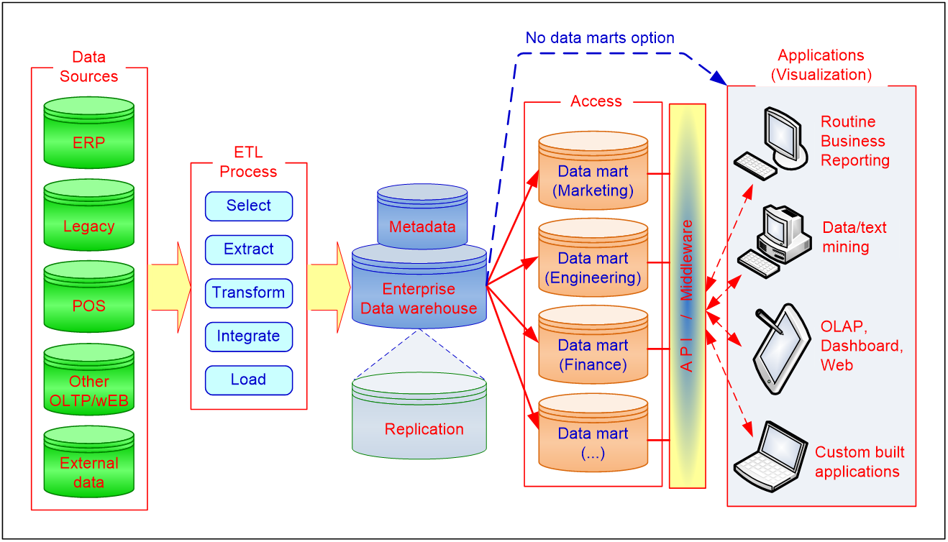
General Data Warehouse Architecture

Slide 4
Data Integration and the Extraction, Transformation, and Load Process

Slide 5
ETL (Extract, Transform, Load)
Issues affecting the purchase of an ETL tool
Data transformation tools are expensive
Data transformation tools may have a long learning curve
Important criteria in selecting an ETL tool
Ability to read from and write to an unlimited number of data sources/architectures
Automatic capturing and delivery of metadata
A history of conforming to open standards
An easy-to-use interface for the developer and the functional user

Slide 6
Best ETL Tools In 2022
1) Integrate.io
2) Skyvia
3) IRI Voracity
4) Dataddo
5) Dextrus
6) DBConvert Studio By SLOTIX s.r.o.
7) Informatica – PowerCenter
8) IBM–Infosphere Information Server
9) Oracle Data Integrator
10) Microsoft – SQL Server Integrated Services (SSIS)
11) Ab Initio
12) Talend – Talend Open Studio for Data Integration
13) CloverDX Data Integration Software
14) Pentaho Data Integration
15) Apache Nifi
16) SAS – Data Integration Studio
17) SAP–BusinessObjects Data Integrator
18) Oracle Warehouse Builder
19) Sybase ETL
20) DBSoftlab
21) Jasper

Slide 7
Objective: Building coffeemerchant Data Warehouse Using Spoon PDI
SQL-script
CoffeeMerchant
database
CoffeeMerchant
Datawarehouse
Power BI
Spoon
ETL

Slide 8
PDI Installation

Slide 9
Installation of PDI (Pentaho Data Integration) tool:
Step 1: Installing Java SE. Any Java SE version between 11 and 18 should work
To check the java version you have:
Open the Command Prompt by searching for cmd in the Windows search bar.
Type java -version and press Enter.
To install Java SE use the link: Java Downloads | Oracle
Click on x64 installer to install Java SE on your laptop
A detailed description on the installation steps can be found here: https://www.hitachivantara.com/en-us/pdfd/implementation-guide/three-steps-to-install-pentaho-data-integration-ce.pdf

Slide 10
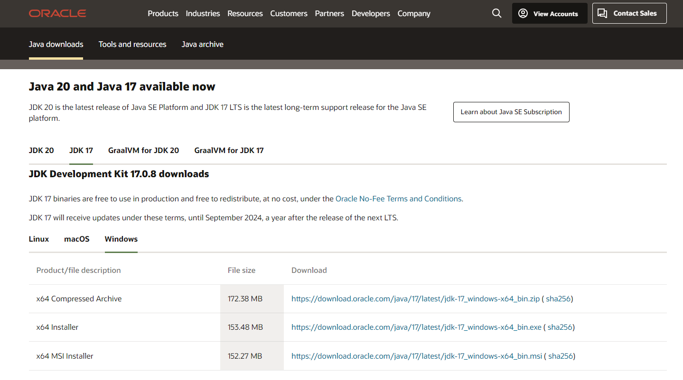
Installation of PDI (Pentaho Data Integration) tool:

Slide 11
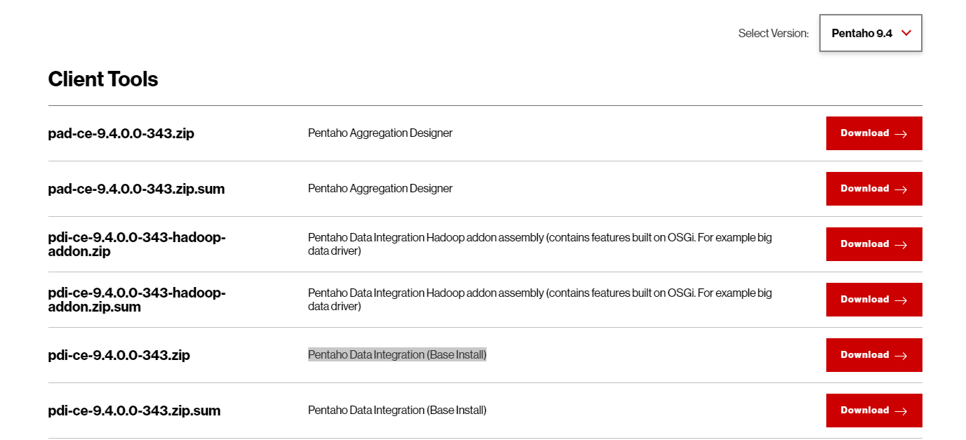
Installation of PDI (Pentaho Data Integration) tool:
Step 2: Download the latest version of Pentaho here: https://www.hitachivantara.com/en-us/products/pentaho-platform/data-integration-analytics/pentaho-community-edition.html

Slide 12
Installation of PDI (Pentaho Data Integration) tool:
Save the downloaded file in a new folder and unzip it.
Inside the unzipped folder, you will find a folder named data-integration.
Open the data-integration folder and locate the file spoon.bat
Click twice on spoon.bat to start Pentaho Data Integration (PDI) tool
Before running the PDI tool, we need to install MySQL connector
MySQL connector will allow the PDI tool to connect to MySQL

Slide 13
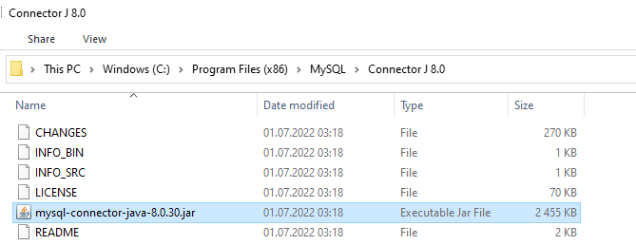
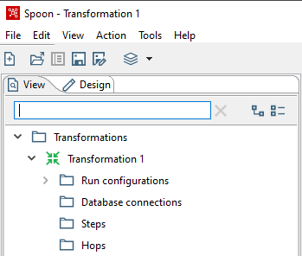
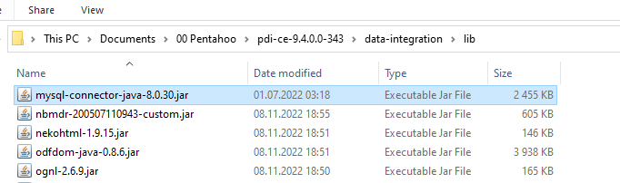
Installing the MySQL connector (NB! before you run PDI):
Look for MySQL connector in the folder: C:\Program Files (x86)\MySQL\Connector J 8.0
Copy MySQL connector to the lib folder in the data-integration folder

Slide 14
System variables (your computer may have other versions of Java):
Notice that we here define the
path down to java.exe in the jre
library
Here the path is to the jre library
Here the path is to the jdk library

Slide 15
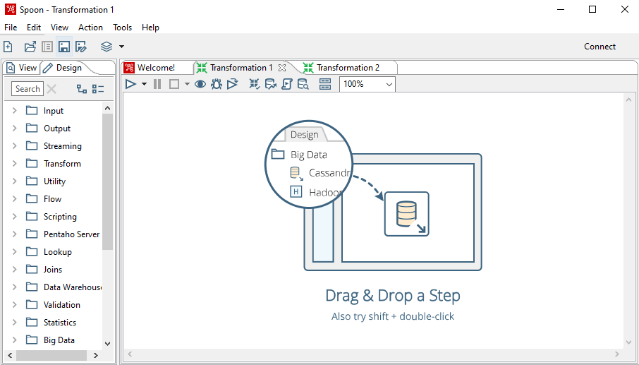
Pentaho Data Integration:
The latest version looks like this :

Slide 16
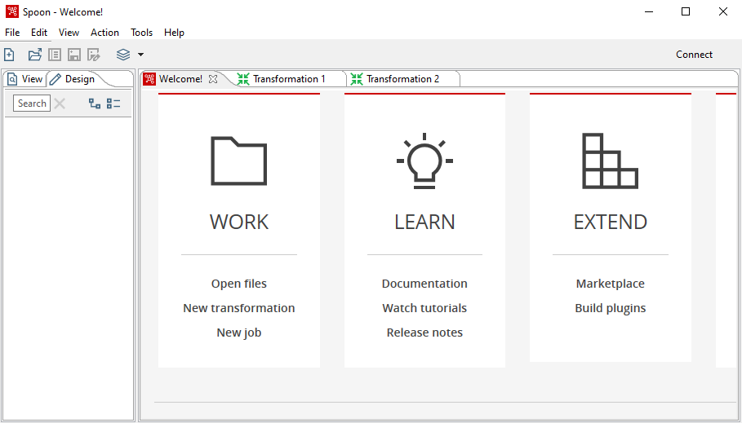
Tutorials for PDI

Slide 17
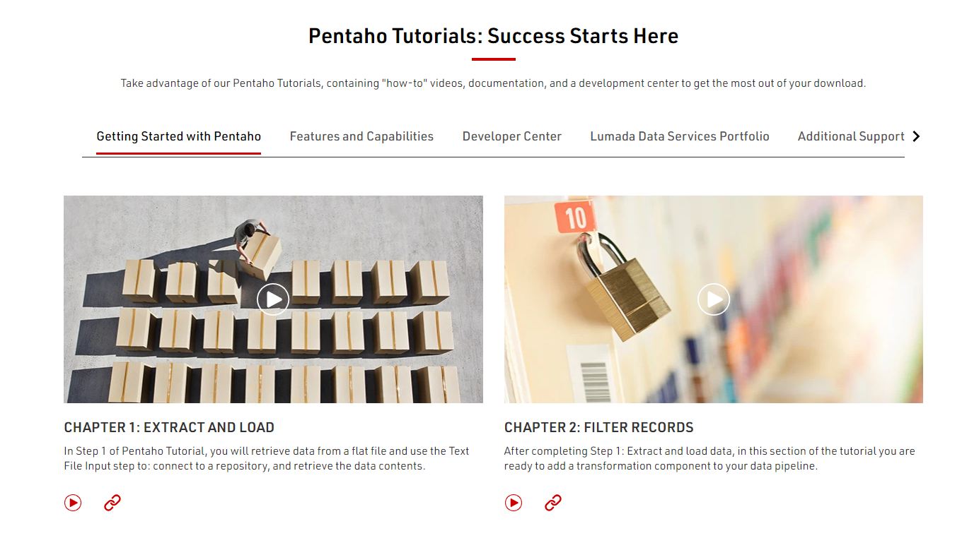
Tutorials for PDI
https://www.hitachivantara.com/en-us/products/pentaho-platform/data-integration-analytics/pentaho-tutorials.html?ecid=ms_glo_bd_en_sscepen02

Slide 18
Basic Transformations

Slide 19
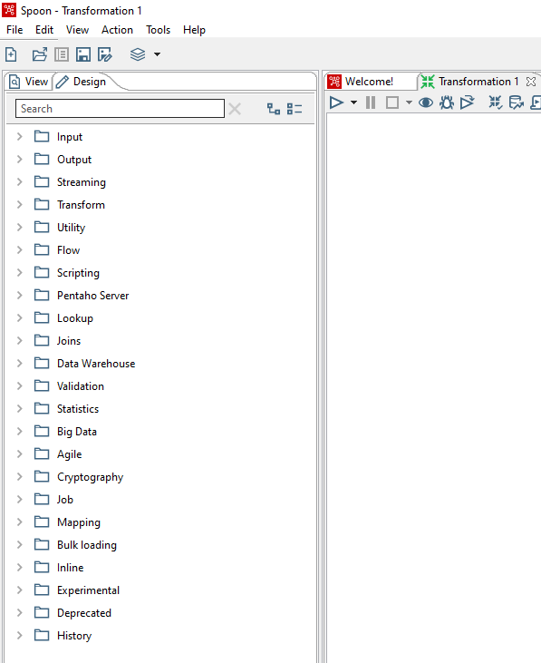
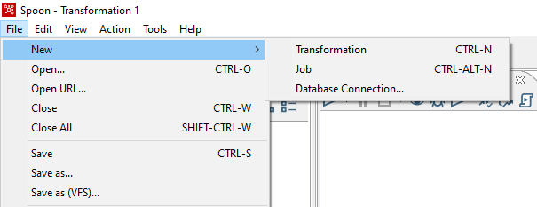
Creating a Transformation: File – New - Transformation

Slide 20
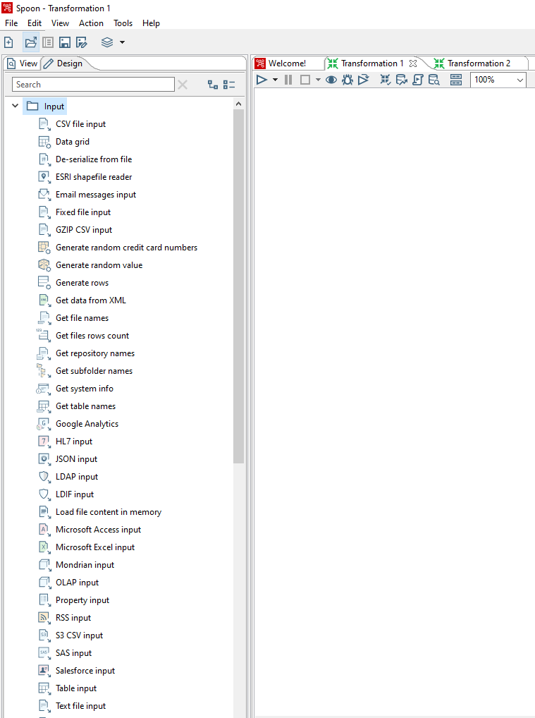
Example of a Design palette: Input

Slide 21
Reminder: Filling dim_customer using SQL

Slide 22
Filling the Data Warehouse:
SQL procedure
dim_time
consumers
dim_customer
inventory
dim_inventory
orders
Staging-tabell
fact_sales
orderLines

Slide 23
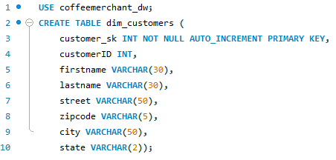
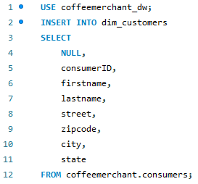
dim_customers:
Creating the table:
Filling the table from the source database :

Slide 24
Filling dim_customer using Spoon

Slide 25
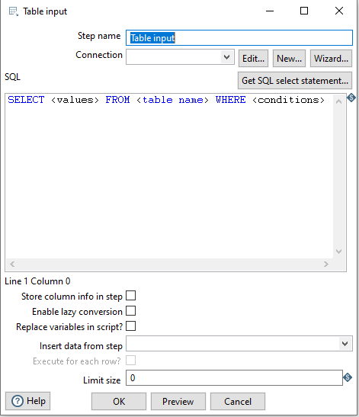
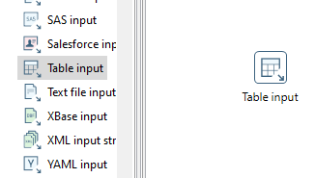
We choose Table input:

Slide 26
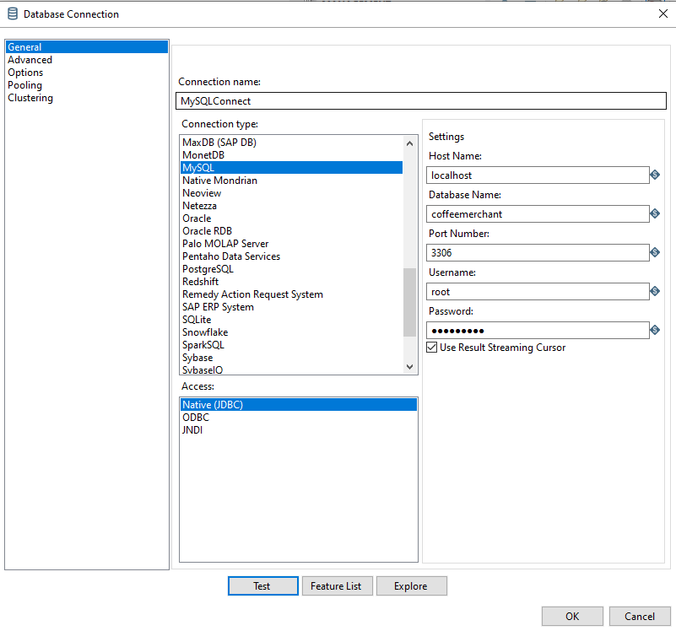
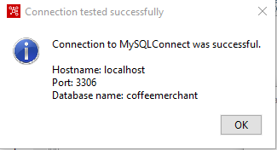
Creating a Database Connection:

Slide 27
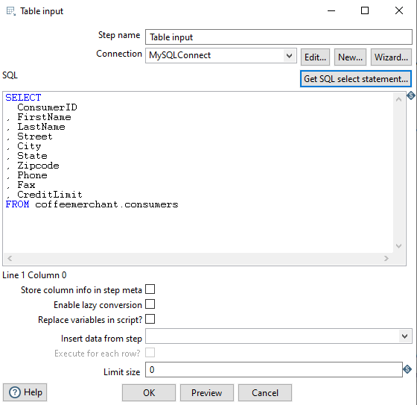
Click Get SQL select statement to choose the table name and include field-names in the SQL Statement

Slide 28
Create a DW coffeemerchant_Spoon_dw
The data need to be copied from the database coffeemerchant to the data warehouse coffeemerchant_Spoon_dw.
We need first to create the data warehouse coffeemerchant_Spoon_dw on MySQL as follows
CREATE DATABASE coffeemerchant_Spoon_dw;

Slide 29
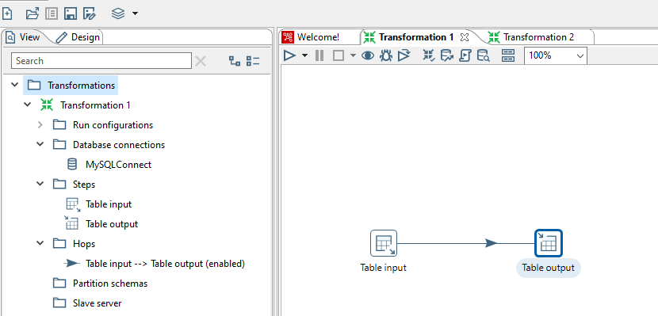
Create an Output Table in Spoon

Slide 30
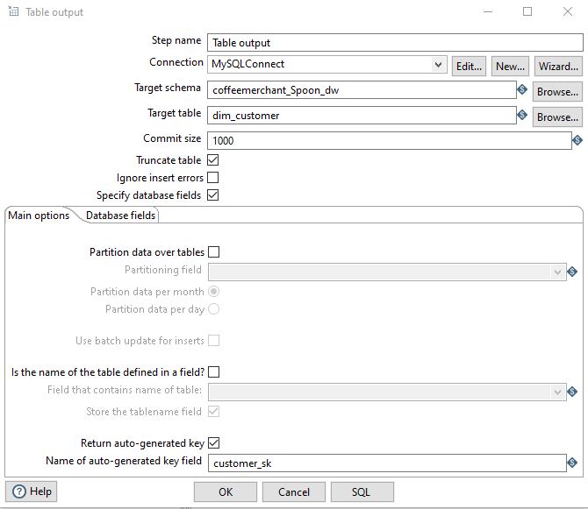
Configuring the Output Table in Spoon

Slide 31
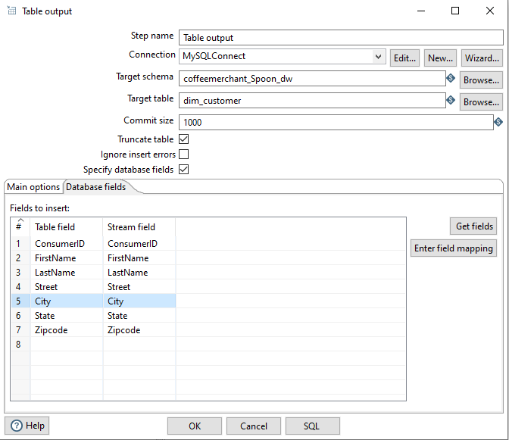
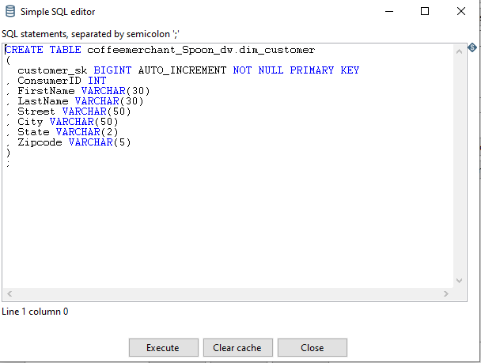
Configuring the Output Table in Spoon

Slide 32
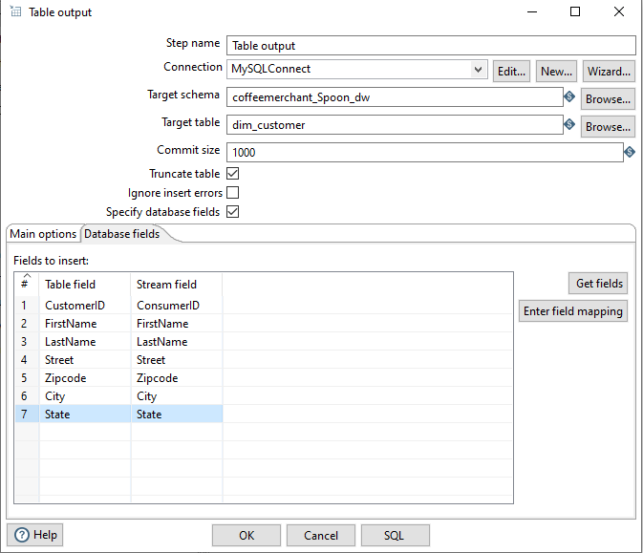
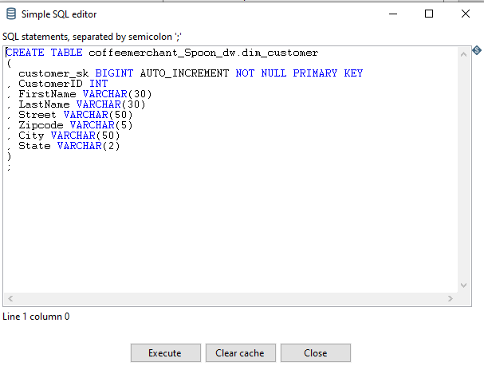
Configuring the Output Table in Spoon

Slide 33
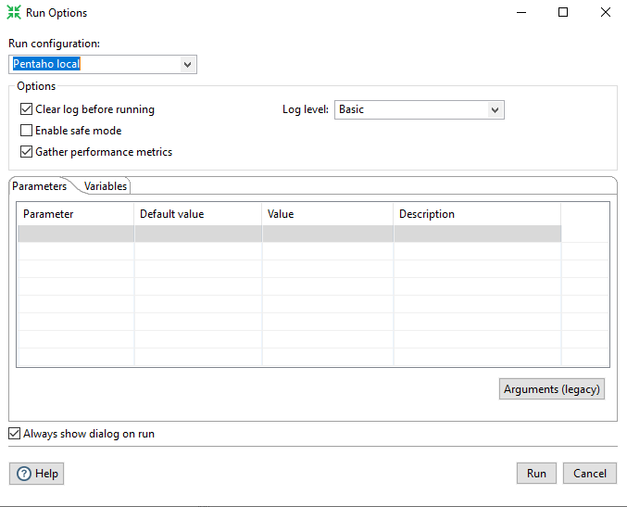
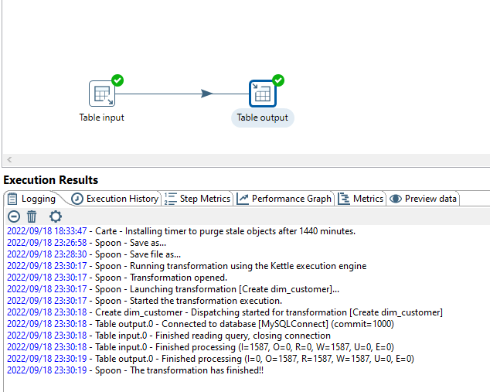
Running the Transformation

Slide 34
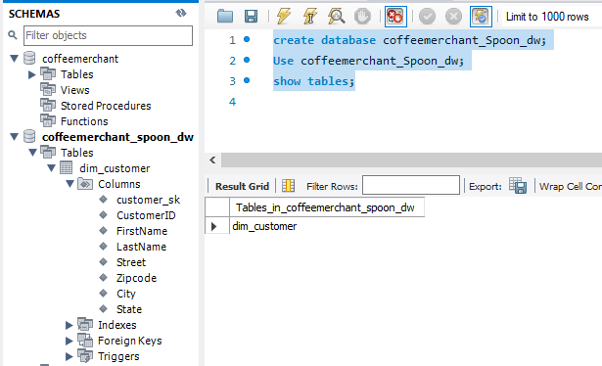
Output Table in MySQL

Slide 35
Basic Example: Reading Data From CSV File to an Output Table

Slide 36
Basic Steps
How to read data from a CSV file?
Start by dragging a text file input in the canvas
Double click then name the step
Browse to provide the path (C:..\Documents\pdi-ce\data-integration\samples\transformations\files\sales_data.csv)
Click Add
Click SHOW FILE CONTENT and NOT Preview the data and find the separator and enclosure and set the format to Unix
Click on fields tab then click get fields button in the bottom
Click content and click preview rows (they should be displayed correctly now)

Slide 37
Basic steps to learn
The next step is to create an output table that is saved on a database already created in MySQL
First step go to MySQL create a database called sampledata
create database sampleData;
Drag a table output in the canvas of the transformation
Double click on the output table
Provide a name for the step (this is optional)
For creating a connection to the database where the output data will be saved click on new
Provide a name for the connection
Choose the connection type: MySQL, PostgreSQL, or Oracle (depending on the DBMS you are trying to connect to)
For the access type choose Native (JDBC)
Now fill the field

Slide 38
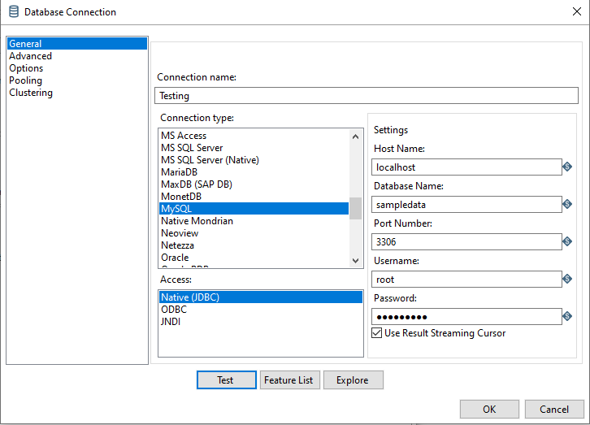
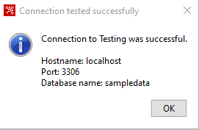
Fill the fields, then test the connection
Click test to test if the connection is working

Slide 39
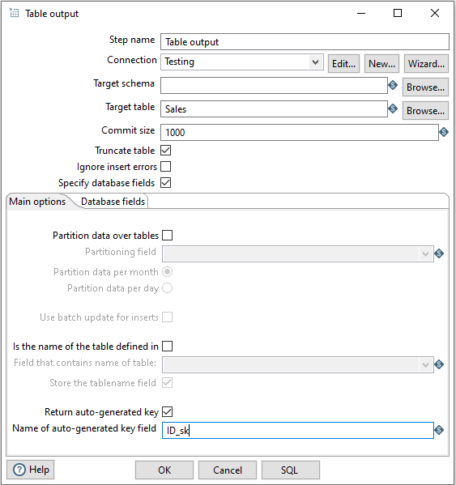
Configure The Output Table
Fill target table name
Click Truncate table
Click Specify database fields
Click Run auto-generated key
Provide the name of the auto-generated key field

Slide 40
Creating Dim-Date

Slide 41
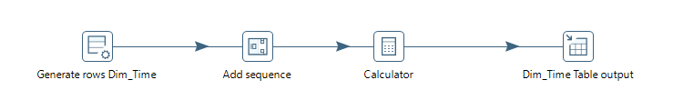
Modelling transformations with PDI:
We start with filling up the time dimension
This is modelled this way in PDI:

Slide 42
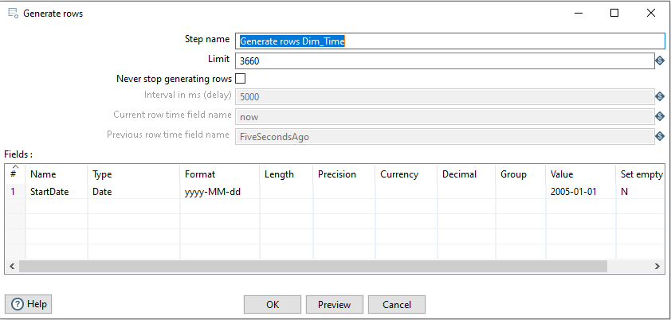
Generating dates:
We start with Generate Rows (Input | Generate Rows):

Slide 43
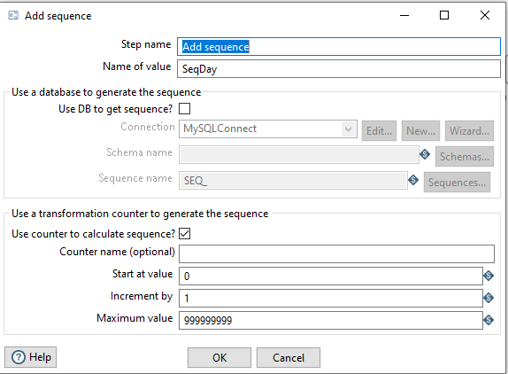
Generating dates:
We define the sequence (Transform | Add sequence):

Slide 44
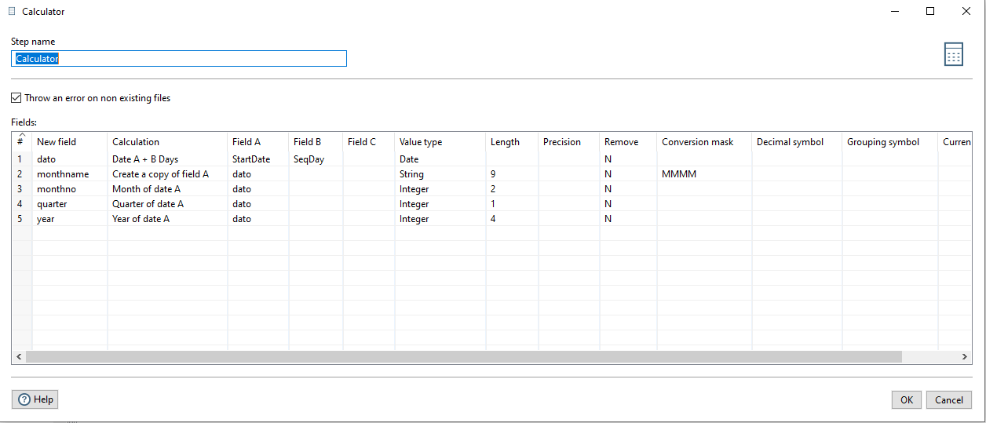
Generating dates:
Setting up calculations in Calculator (Transform | Calculator):

Slide 45
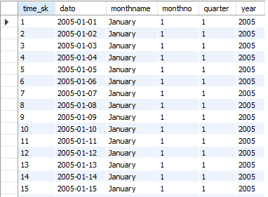
Generating dates:
Loading to the table dim_tid:

Slide 46
Assignment

Slide 47
Objective: Building coffeemerchant Data Warehouse Using Spoon PDI
SQL-script
CoffeeMerchant
database
CoffeeMerchant
Datawarehouse
Power BI
Spoon
ETL

Slide 48
Creating the Data Warehouse Using Spoon
Spoon Transformation
dim_time
consumers
dim_customer
inventory
dim_inventory
orders
Staging-tabell
fact_sales
orderLines

